Slide 1
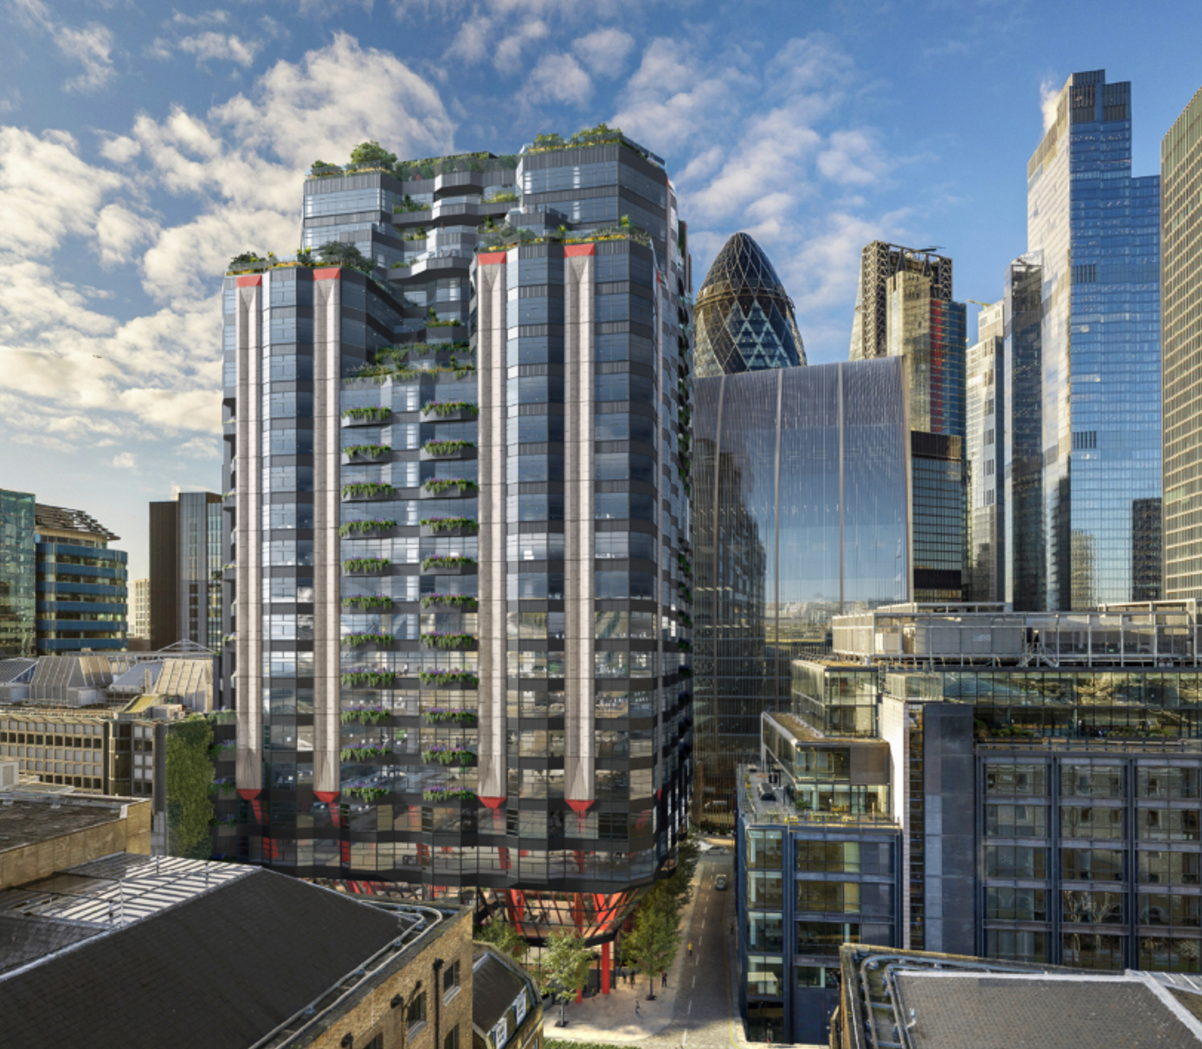
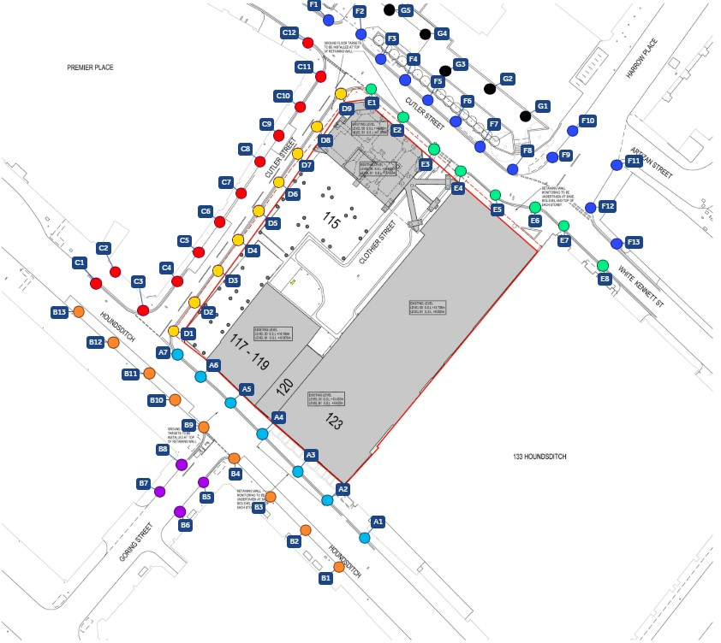
THE DOVETAIL BUILDING
Building and Tunnel MONITORING
Complete monitoring for demolition and construction works, including nearby buildings, streets and excavation structure.
Automated 3D monitoring of TFL underground assets near new excavation.
Building Monitoring
Tunnel Monitoring
The Project
The Dovetail Building will be a 23‑storey office development near to the City and Spitalfields. Designed as a flexible and sustainable workplace including amenities, retail, and public realm spaces. Early stages of the project require significant demolition and excavation works.
The Challenge
The location of the project is already heavily developed, and the site is surrounded by existing buildings and infrastructure. The monitoring scheme must adequately measure the impact of construction works on the surrounding buildings, nearby streets and TFL Underground tunnels.
The Solution
GEO-Instruments At street level, survey teams are carrying out manual 3D monitoring of structures and assets surrounding the site as well as precise levelling across adjacent roads. Around the perimeter of the development, 24-hour monitoring of noise, dust and vibration is achieved with automated environmental sensors. Twelve 25-metre manual inclinometers will be installed in the wall around the excavation and read manually throughout key construction phases.
Below the surface, alongside the site, additional monitoring is taking place within a London Underground tunnel. Two automated total stations have been installed, taking regular readings from more than 100 geodetic prisms fixed to the tunnel lining. Custom-made brackets were designed and fabricated to mount the total stations above the tracks on the crown of the tunnel.
Readings from both total stations are processed as a common prism network via QuickAdjust, a module of GEO-Instruments' QuickView software platform. This automates the StarNet adjustment and feeds calculated values directly into QuickView for visualisation alongside the project’s other monitoring data.
Automated monitoring
Environmental Monitoring
Survey and Manual Monitoring
Construction
3+ years
Automated Total Stations GRP 3000 Track Trolley Noise, Dust and Vibration sensors Precise Level
GEO-Instruments
www.geo-instruments.co.uk │ info@geo-instruments.co.uk │ 0207 709 2030

Slide 2



Geotechnical & Structural Monitoring Solutions
www.geo-instruments.co.uk │ info@geo-instruments.co.uk │ 0207 709 2030

